Slide 1
Solving 2-D Vectors Graphically
Physics

Slide 2
Why?
You can and people have accurately represented a situation by drawing vectors to scale in order to recreate exactly where they (some object) would end up.

Slide 3


How?
There are 7 steps to use to solve vectors using graphical techniques.
If you follow the steps, the vector solves itself.

Slide 4

Step 1 – Make a key
You need to know what the scale is for your drawing.
For example →
1 cm in the drawing = 25 m in real life
It is a scaled down version of reality and we need to know how scaled down it is.

Slide 5

Step 2 - Show Direction
Which direction is North? Put compass directions on the drawing so we know North/South/East/West

Slide 6
Step 3 – Convert values and draw vectors to scale
Take the values given to you, and convert them using your key. (Be sure to show your work).
Now use a ruler and protractor and draw the scaled down vectors on your graph paper as arrows in the correct direction and with the correct length.
Be sure to draw the first from an origin point, and each vector after that from the head of the previous vector arrow

Slide 7
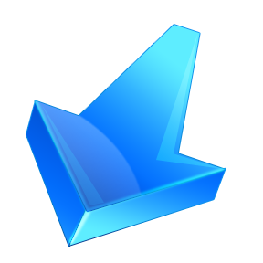
Step 4 – Draw the resultant vector
Start at the origin point, and draw a single arrow extending from that origin point to the head of the final arrow.
This one here

Slide 8
Step 5 – Measure and convert the resultant vector
Use a ruler and measure the resultant vector.
Now convert it back to the real length using your key conversion factor.

Slide 9
Step 6 – Measure the angle
Use a protractor and measure the angle.
Start at the origin point and measure the angle from the closest horizontal or vertical axis to the resultant vector line.
This will be an angle under 90 degrees.

Slide 10
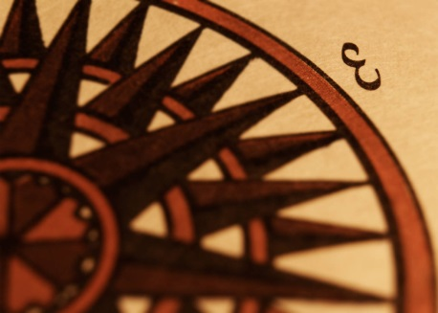
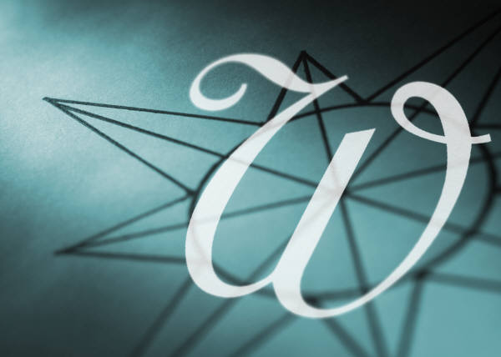
Step 7 – Find the direction of the angle
Now determine the direction of the angle relative to one of the Cardinal directions (North/South/East/West)
Examples → West of North, South of East

